Slide 1
Sarath Kumar L
Final Project

Slide 2
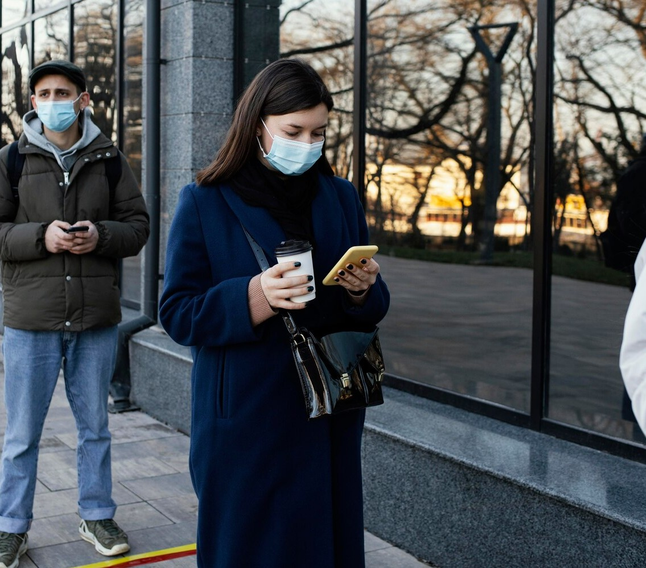
Project Title
Face mask detection with Machine Learning

Slide 3

Agenda
Face mask detection has a range of applications from capturing the movement of the face to facial recognition which at ﬁrst requires the face to be detected with very good precision. Face detection is more relevant today as it is not only used on images, but also in video applications like real-time surveillance and face detection in videos.
High precision image classiﬁcation is now possible with advances in convolutional networks. Pixel level information is often needed after face detection, which most face detection methods do not provide.

Slide 4



Machine Learning Implementation
Utilizing computer vision and deep learning algorithms, a system can be trained to identify individuals not wearing face masks.
This technology can be integrated into existing security systems for eﬃcient monitoring.

Slide 5
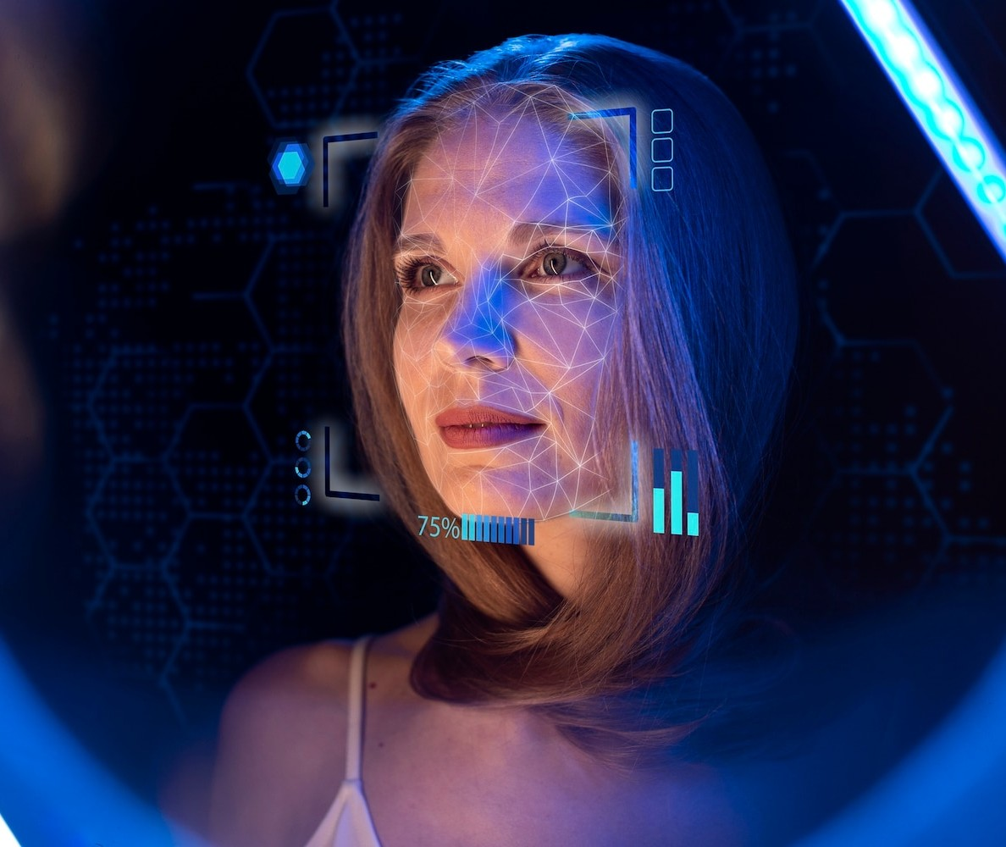

Challenges and Considerations
There are various ethical and privacy concerns associated with face mask detection using machine learning. Additionally, the accuracy of the system and potential biases in detection must be carefully addressed.

Slide 6



Real-World Applications
From retail stores to public transportation, the implementation of face mask detection technology can signiﬁcantly enhance public safety.
This can contribute to a safer environment for both customers and
employees.

Slide 7

Future Developments
Continued advancements in machine learning and computer vision will lead to more accurate and reliable face mask detection systems. The integration of this technology into various sectors will further contribute to public safety.

Slide 8




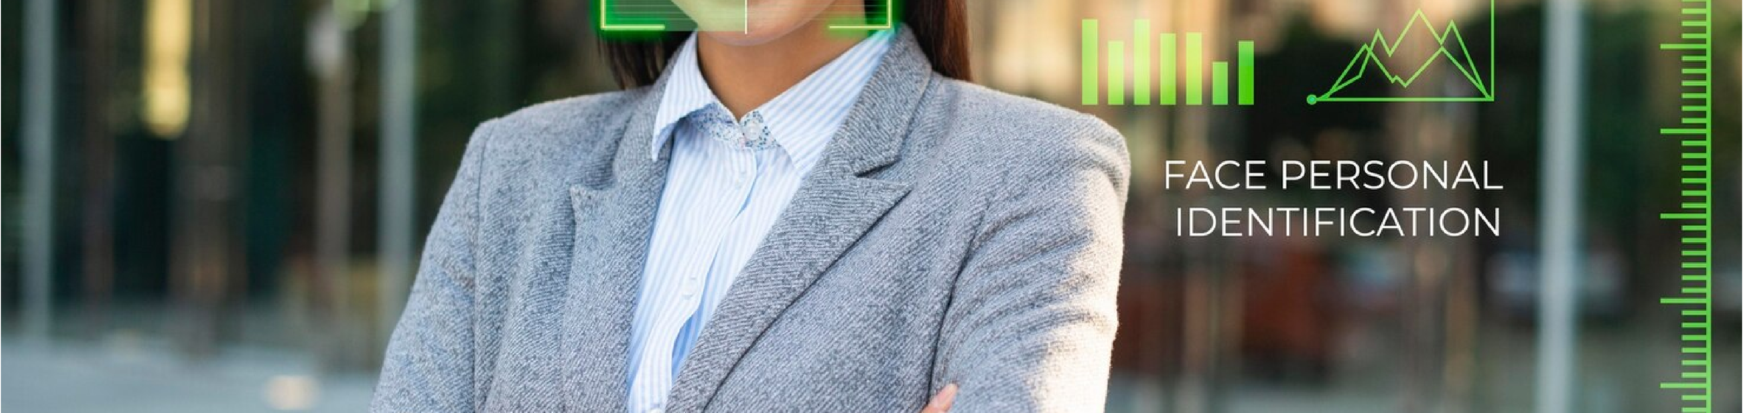
Implementation Challenges
The successful implementation of face mask detection systems requires collaboration between technology developers, regulatory bodies, and privacy advocates.
Addressing these challenges is crucial for widespread acceptance and adoption.

Slide 9
Conclusion
In conclusion, the integration of machine learning for face mask detection holds immense potential for enhancing public safety. However, it is essential to navigate the associated ethical and privacy considerations to ensure its responsible use.

